Slide 1
CITY OF MIAMI POLICE DEPARTMENT ULTRA MUSIC FESTIVAL 2018 MPD SPECIAL EVENTS UNIT OFFICE HOURS 8AM – 4PM CONTACT INFORMATION (305) 603-6510 UNIT COMMANDER LT. GILBERTO GOMEZ

Slide 2
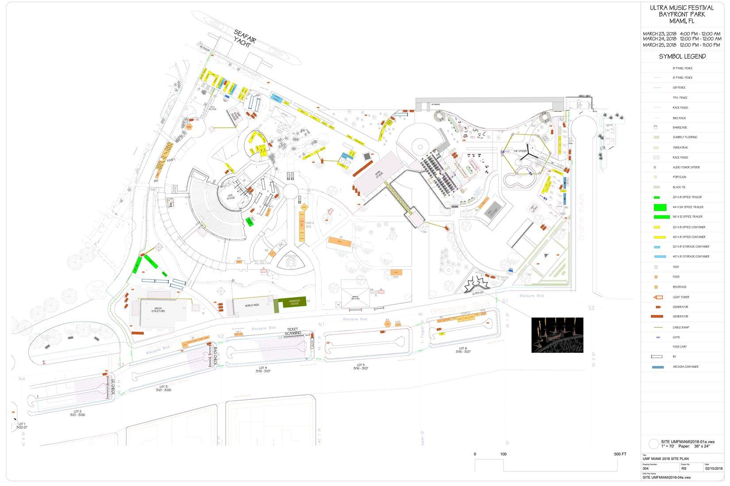
EVENT MAP

Slide 3
TRAFFIC FLOW

Slide 4
BAYFRONT PARK
LOAD IN (CONSTRUCTION) BEGAN ON MONDAY MARCH 5
THE PARK WILL HAVE LIMITED PORTIONS OPEN TO THE PUBLIC
CLOSED SPACES WILL BE DICTATED BASED ON THE BUILD
BREAKDOWN STARTS IMMEDIATELY AFTER THE EVENT (SUNDAY 3/25)
SCHEDULED TO RE-OPEN AFTER ALL BREAK-DOWN IS COMPLETE
GRADUAL PARTS OF THE PARK WILL THEN BE AVAILABLE

Slide 5
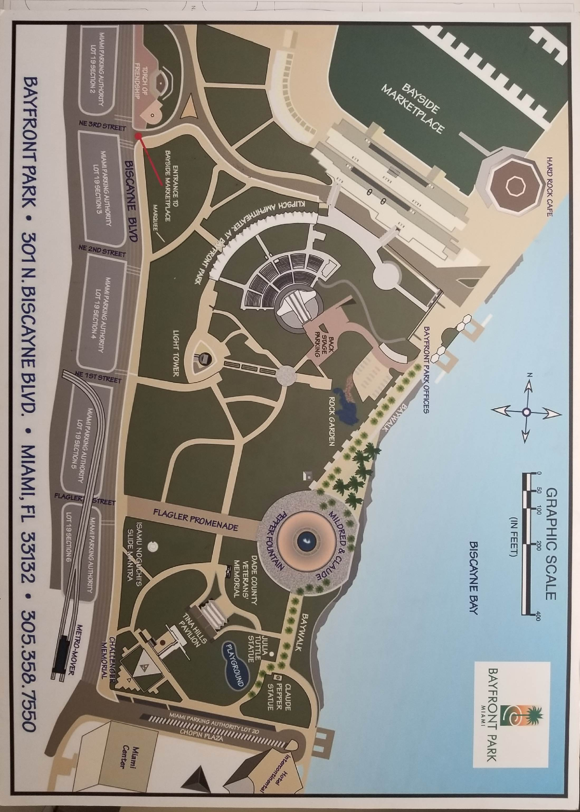

Slide 6
EVENT SCHEDULE
LIGHT AND SOUND CHECKS TO BE CONDUCTED THE WEEK OF THE EVENT
2017 – TUESDAY THRU THURSDAY 5PM-10PM – FRIDAY 12 NOON-4PM
FRIDAY SOFT CHECKS STARTING AT 12PM AND FULL SOUND BY 4PM
SATURDAY AND SUNDAY SOFT CHECKS STARTING AT 9AM AND FULL SOUND BY 1PM
TRAFFIC
THURSDAY 3/22 RE-ROUTE TO BE IMPLEMENTED AT 9PM – HEAVY POLICE PRESENCE
FRIDAY 3/23 GATES OPEN AT 4PM – EVENT ENDS AT MIDNIGHT
SATURDAY 3/24 GATES OPEN AT 12 NOON – EVENT ENDS AT MIDNIGHT
SUNDAY 3/25 GATES OPEN AT 12 NOON – EVENT ENDS AT 11PM
MONDAY 3/26 ALL TRAFFIC OPEN BY 6AM

Slide 7
SAFETY MEASURES
HEAVY POLICE PRESENCE THROUGHOUT THE WEEKEND (NIGHTS INCLUDED)
FORMULA “E” RACING FENCING (USED ON RACE TRACKS)
18 AND OVER POLICY WITH ID CHECKS
CLEAR BAG POLICY
ENTRY MONITORING WITH EXIT CHUTES FOR ILLEGAL ENTRY ATTEMPTS
AMNESTY BOX AT ENTRY (USED TO DISPOSE NARCOTICS/WEAPONS/ETC.)

Slide 8
STAFFING:
THURSDAY (NIGHT) = (2) LT – (3) SGT – (21) OFC.
FRIDAY = (1) CAPT – (5) LT – (29) SGT – (283) OFC. – (22) PSA
FRIDAY (NIGHT) = (1) LT – (2) SGT – (20) OFC.
SATURDAY = (1) CAPT – (5) LT – (27) SGT – (257) OFC. – (23) PSA
SATURDAY (NIGHT) = (1) LT – (2) SGT – (20) OFC.
SUNDAY = (1) CAPT – (5) LT – (26) SGT – (263) OFC. – (22) PSA
SUNDAY (NIGHT) = (1) LT – (2) SGT – (20) OFC.

Slide 9
SERVICES
SOLID WASTE WILL BE ON-SITE ALL EVENT DAYS
AREAS COVERED BISCAYNE BLVD TO MIAMI AVENUE – NW MIAMI RIVER DR TO NE 12 ST
METRO RAIL / METRO MOVER REMAINS OPEN AN ADDITIONAL HOUR
METRO BUS
ROUTES CAN BE ACCESSED AT THE MIAMI GOVT. CENTER 111 NW 1 STREET
NW 1 AVENUE/NW 1 STREET – NW 1 AVENUE/FLAGLER STREET
NB BUS TRAFFIC RE-ROUTED TO NE 1 AVENUE
SB BUS TRAFFIC RE-ROUTED TO MIAMI AVENUE
PARKING LOTS
LOT A/B NW 3 STREET/1 AVENUE // LOT13 NE 3 STREET/3 AVENUE

Slide 11
OTHER AREA EVENTS (ULTRA WEEKEND)
PAC – FRIDAY 3/23 – 6PM MPD PRESENCE – 8PM EVENT START (ZBOH – ORFEO ED EURIDICE)
PAC – SATURDAY 3/24 – 6PM MPD PRESENCE – 8PM EVENT START (ZBOH – ORFEO ED EURIDICE)
PAC – SATURDAY 3/24 – 6PM MPD PRESENCE – 8PM EVENT START (KCH – 12TH ANNIVERSARY)
888 MAC ARTHUR CSWY – SATURDAY 3/24 – 1PM MPD PRESENCE –(YUMMY APP LOUNCH)
300 BISCAYNE BLVD – 3/22 TO 3/25 – 12NOON TO MIDNIGHT (LIBERTY PARK BEER GARDEN)
ADDITIONALLY, HOTELS, RESIDENTIAL BUILDINGS TYPICALLY HOST THEIR OWN PARTIES

Slide 12
UBER
UBER HAS REQUESTED TO MOVE FROM THE INITIAL LOT LOCATED AT BISCAYNE AND 6 STREET TO NE 2 AVENUE IN BETWEEN 2-5TH STREET.
BASED ON LAST YEAR’S PICK-UPS, UBER HAS ADVISED THAT USING THE PARKING LOT ACROSS THE AMERICAN AIRLINES ARENA WOULD ONCE AGAIN CAUSE SEVERE TRAFFIC CONGESTION.
UBER HAS RESPECTFULLY REQUESTED TO RENT OUT ALL THE PARKING SPOTS (EAST AND WEST SIDES) ON NE 2 AVENUE BETWEEN 2- 5TH STREET TO FACILITATE FASTER PICKUPS AND EGRESS MOVEMENTS OF THEIR VEHICLES.
THEY WOULD ALSO PROVIDE SECURITY AND PERSONNEL TO MONITOR THESE SECURED SPACES TO ENSURE NO UNAUTHORIZED VEHICLES WOULD PARK THERE.
UBER HAS ADVISED THAT A BUSINESS TENT WOULD BE SET UP AROUND ULTRA, ENSURING PATRONS ARE INFORMED OF THIS CHANGE.
ALL THESE REQUESTS ARE PENDING APPROVAL BY MPD PERSONNEL

Slide 15
QUESTIONS / COMMENTS

