Slide 1
Tax Reform
January 2013
Administration & Finance

Slide 2
Our Goals
In order to invest in education, innovation, and infrastructure, the Patrick-Murray Administration proposes to generate new revenue in accordance with these principles:
Any proposal to generate new revenue must be comprehensive, allowing us to pay our bills, maintain what we have, and invest in new development to foster economic growth
Any proposal to generate new revenue for transportation must be dedicated for that purpose
Any proposal to generate new revenue must be competitive and fair, both allowing Massachusetts to compete with our neighbors and protecting the most economically vulnerable among us

Slide 3
Tax Revenue Proposal
 | Status Quo | New Rates | Policy Changes | Revenue
Personal Income | 5.25% $4,400/ $6,800/ $8,800* | 6.25% $8,800/ $13,600/ $17,600* | Increase rate to 6.25% (lower rate for short term capital gains to 6.25%) | $2.57B | $2.81B
 |  |  | Increase personal exemption 2x | ($1.09B)
 |  |  | Eliminate 45 tax expenditures | $1.33B
Sales | 6.25% | 4.50% | Lower rate to 4.50% | ($1.37B) | ($1.10B)
 |  |  | Tax custom modifications to canned software and related computer services | $265M
Corporate Income | 8.00% | 8.00% | Eliminate FAS 109 deduction | $76M | $194M
 |  |  | Eliminate special classifications for security and utility corporations | $83M
 |  |  | Implement sales factor sourcing for services | $35M
Total |  |  |  |  | $1.90B
*Personal exemption for Single/Head of Household/Joint filers.

Slide 4
Impact to People

Slide 5
Allocation of New Tax Revenue: FY14-FY18 and FY23

Slide 6
Transportation Need for New Tax Revenue
FY14-FY23 Transportation Financing Gap from
“The Way Forward” Report
Periodic, consistent fare/fee/toll increases (maintain real impact) and Western AET savings
MassPort / Gaming / Convention Center contributions
Indexing gas tax to inflation (maintain real impact)
FY14 | FY15 | FY16 | FY17 | FY18 | FY23
$231M* | $600M | $700M | $755M | $755M | $755M
*FY14 allocation reflects items that can be implemented immediately and the launch of the capital program.

Slide 7
Transportation Need: Solutions from Current Tools
(Not Including Gas Tax)

Slide 8
Transportation Need: Solutions from Indexing Gas Tax
Indexing the gas tax to inflation, beginning in FY14, would generate $118M in additional revenue by FY21.
Note: Analysis assumes 2% annual inflation.

Slide 9
Gas Tax
Fully funding the transportation investment would require increasing the gas tax to 60 cents per gallon (47 cents after solutions from current tools).
Data source: Federation of Tax Administrators.

Slide 10
Public Infrastructure Fund
All sales tax will go to a new Commonwealth Public Infrastructure Fund
  Including amounts already pledged to the School Building Authority, the MBTA, and MassDOT
Amounts pledged to the School Building Authority, the MBTA, and MassDOT pass-through the fund without harm to funds or bonds supported by those funds
Amount pledged to MassDOT will be increased to cover transportation gap
The fund may be used for direct expenditure by the Commonwealth, grants, or debt service related to any public infrastructure
The fund is not intended for governmental infrastructure such as state offices or information technology, soft assets such as master plans, or administrative costs such as payroll

Slide 11
Sales Tax Dedicated Entirely to Transportation and Infrastructure
Transportation ranges from 1.02 to 1.32 cents for FY15-FY23 (2.14 to 2.44 cents including the MBTA).

Slide 12
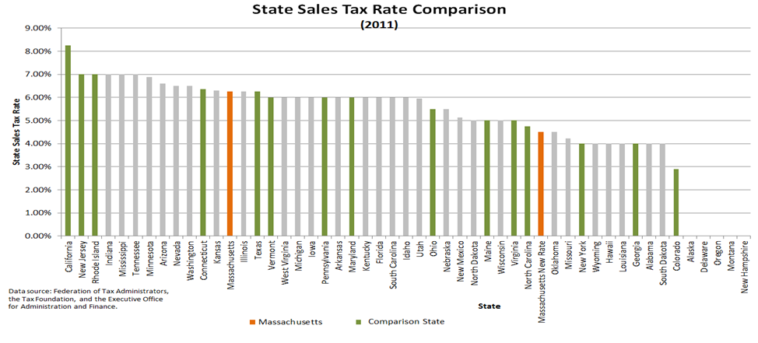
Economic Competitiveness: Comparison to Other States
Highlighted comparison states include neighbors (CT, ME, NH, RI, VT), industry competitors (CA, NJ, NY, OH, PA), and those ranked best for business (CO, GA, NC, VA, TX).

Slide 13
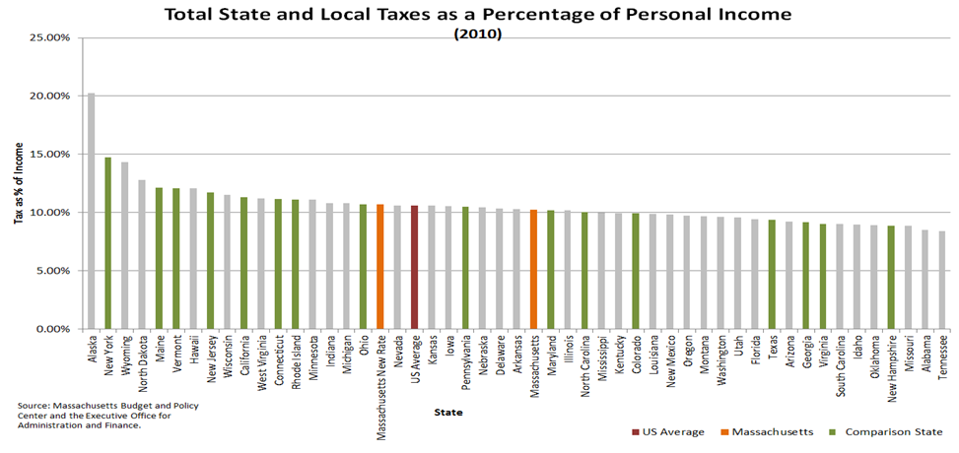
Economic Competitiveness: Comparison to Other States
Highlighted comparison states include neighbors (CT, ME, NH, RI, VT), industry competitors (CA, NJ, NY, OH, PA), and those ranked best for business (CO, GA, NC, VA, TX).

Slide 14
Personal Tax Expenditures
Proposal eliminates 45 personal tax expenditures
This simplifies the tax code
If the goal is also a fairer tax code, reducing the sales tax and doubling the personal exemption is a more efficient way to achieve that result than retaining these personal tax expenditures
Impacts on individuals must be considered in light of all tax changes in the proposal, including reducing sales tax and doubling personal exemptions

Slide 15
Personal Income Tax Expenditures: Proposed for Elimination

Slide 16
Personal Income Tax Expenditures: Retained

Slide 17
Corporate Tax Breaks
Within the category of computer systems design and related services, 29 other states tax modifications to canned programs, and 14 other states tax custom programs
With the migration of software first to the ‘web’ and now to the ‘cloud,’ the line between software (currently taxable) and computer services (not taxable) is becoming untenable, and making these distinctions is difficult both for DOR and taxpayers

