Slide 1
Money Room Security Assessment
June 29, 2016

Slide 2
Money Room Security Assessment: Summary
As part of review of all MBTA operations, private sector experts with more than 75 years of experience retained to assess MBTA cash operations, including whether the function should be out-sourced
Expert team conducted review, site visits, walkthroughs, interviews with MBTA personnel, and evaluations of processes and procedures.
As review proceeded, team identified immediate risks and vulnerabilities to facility and employees
Led to intensive security review, in cooperation with MBTA security department
Immediate actions taken and management changes made to render facility secure

Slide 3
Money Room Security Assessment: Background
Problems with MBTA Money Room operations and procedures long identified, including 2012 review by State Auditor that found hardware and software deficiencies had led to a $101 million variance over five years
Money Room employees and Transit Police protecting them and the building received poor or limited management direction
Money Room supervision consisted of union members overseeing other union members, with no independent MBTA executive leadership in place

Slide 4
MBTA Money Room Functions
$119M is counted from MBTA vehicles and fare vending machines
There are 335 fare vending machines at 117 rail stations and other locations that accept cash
More than 1,400 fare boxes on buses and Green Line vehicles
$75M+ is collected and counted for City of Cambridge, City of Boston, and Mass DOT
From parking meters, tolls, and other revenue
71 MBTA employees are responsible for the collection, safe transport, deposit, and reconciliation of cash
Annual operating costs are $8.6M+
Annual capital costs are $208K+ (facilities, cameras, and security vehicles)
60,000 sq. ft. facility with appraised value of $2.7M - $4M
Facility requires $500k+ in capital investment to continue operations
MBTA, which is self-insured, bears all risks associated with these activities

Slide 5
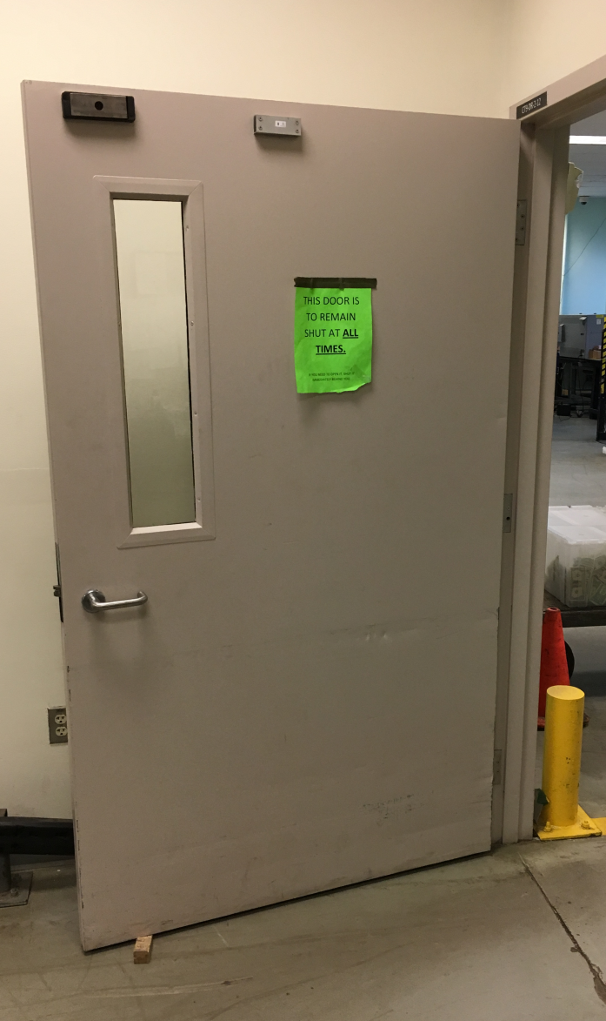
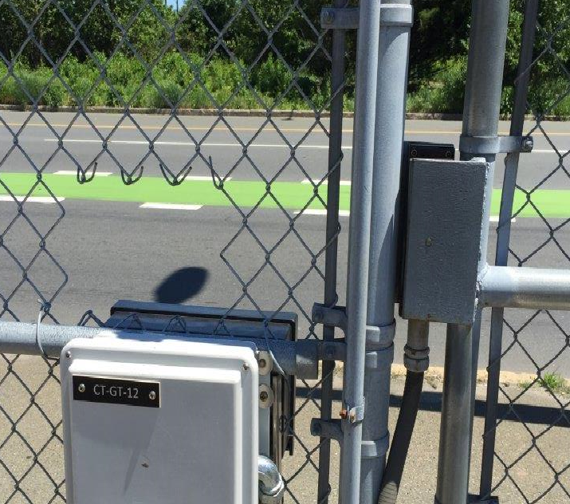
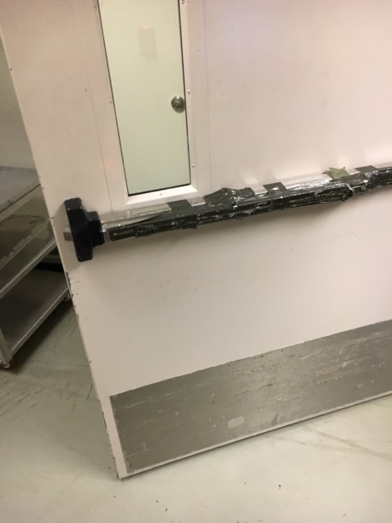
Money Room Security Weaknesses and Risks
Employees and assets were inadequately protected, risking:
Intrusion
Coercion
Physical Danger
Theft
THIS DOOR IS TO REMAIN SHUT AT ALL TIMES

Slide 6
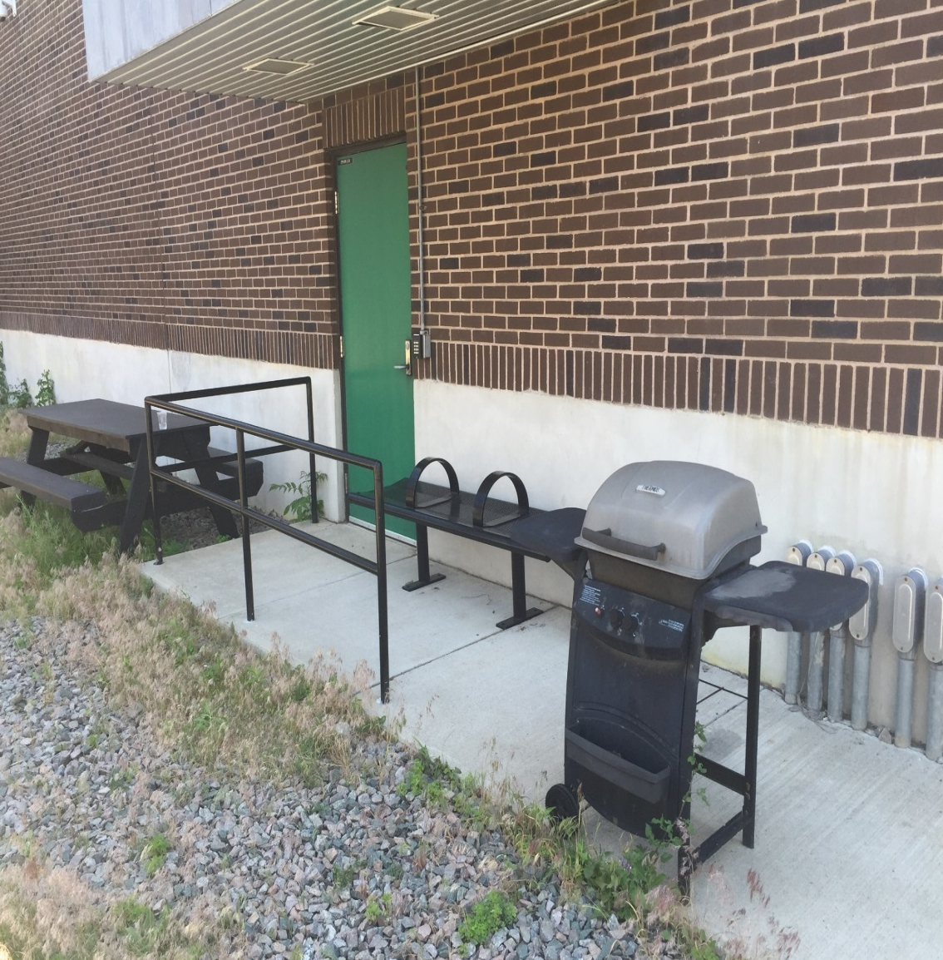
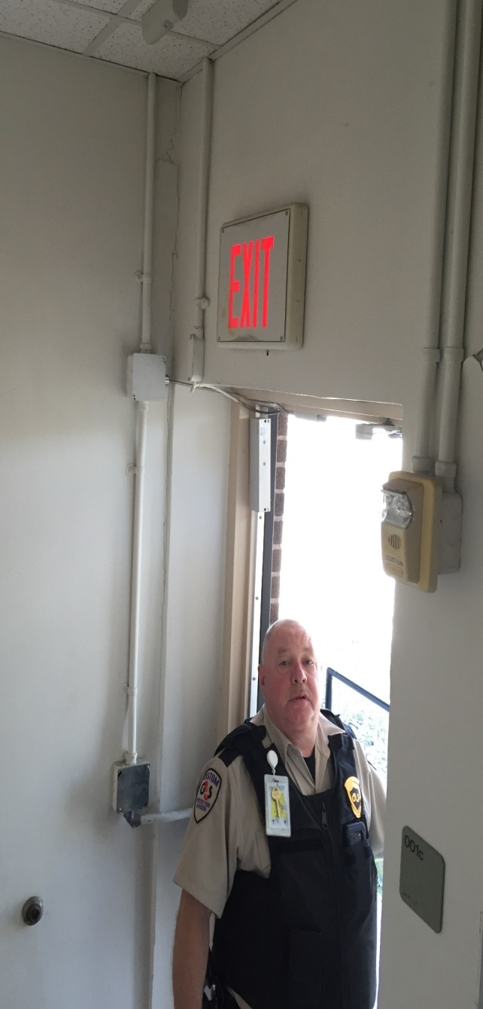
Door to outside not alarmed or access controlled, which allowed unsecured access

Slide 7
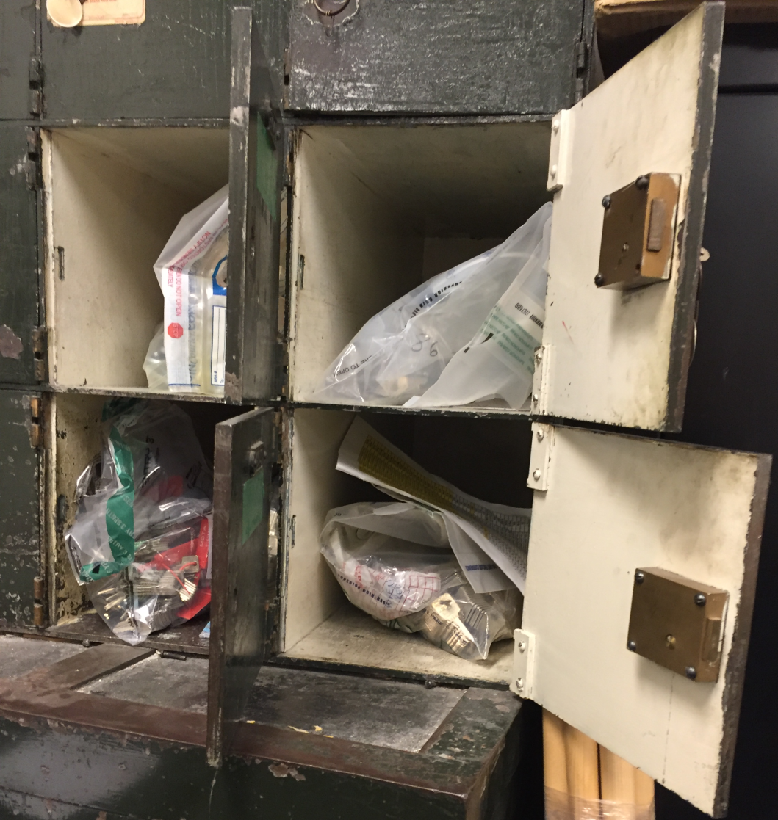
MBTA Money Room Security Weaknesses and Risks
Employee IDs were not verified before entering building
License to carry firearms were not consistently checked
Key control policies not followed
No chain of key custody
Keys not checked in in accordance with SOPs
No inventory system
Vehicle and cashbox keys unaccounted for
Keys are stored without appropriate controls

Slide 8
MBTA Security Report Card
Industry Standard | MBTA | MBTA
Physical Security Based on observed practices and an audit conducted by MBTA Security Office | Security doors bypassed, including propped open, vault room door duct taped, alarm contacts not functional Vault room access unrestricted Non-alarmed doors Cameras missing or removed at guard stations Outside gates secure with locks with unaccounted for keys Unsecured freight elevator Lack of interlocking doors staggering access to the vault
Opening and Closing Procedures | Staff enters building without full TPD clearance of building Building is not fully cleared
Keys and Codes | Lack of dual control Time locks not utilized Many individuals capable of opening vault alone, a violation of dual custody standard Keys not securely managed and inventoried
Facility Access | Employees not checked for ID or required to wear ID Employees have access to cash floor and vault room Generic guest key cards allow full access to the facility Frequent vendors and outside employees allowed same access as employees Vendors arrive unscheduled and gate is opened for them

Slide 9
Immediate Security Threats Triggered Immediate Actions
Notified MBTA Transit Police Department (TPD) of weaknesses and risks
Developed security transition plan in coordination with TPD
Enhanced money room security with combination of TPD and private security personnel, including armed guards
Revenue agents now required to present identification and proof of license to carry before accessing firearms
Reinstituted employee and visitor screening policies, requiring all bags to be screened by security upon entry and exit
Vault combination re-tumbled and reestablished dual control practices for vault access
Instituted “single door policy” requiring no more than one door between vault and street to be opened at any given time
New opening procedures in place. Security now clears building before employees are admitted to secure areas
Reinstituted employee uniform policies

Slide 10
Changes in Money Room Management
On-site union supervisors of other union members replaced with executive managers
Four of four top managers no longer in those positions
Investigation continues into security lapses

